Slide 1
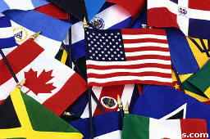
RELATED ISSUE 3 Social 20-1
Should internationalism be pursued?

Slide 2
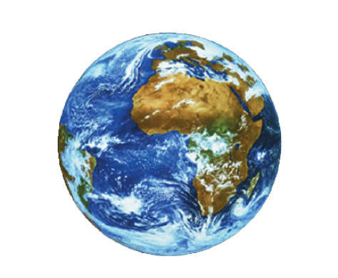

The World is Shrinking…

Slide 3
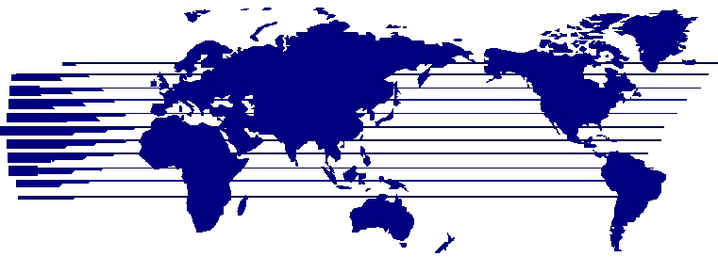
SHOULD INTERNATIONALISM BE PURSUED?

Slide 4
Motives of People/Maslow’s Hierarchy of Needs
People and nations are motivated in life by WANTS and NEEDS
NEEDS are basic to human survival
WANTS are things people desire, not necessarily needed for survival
Maslow says all humans are motivated to meet their survival needs
Structured this as a pyramid

Slide 5
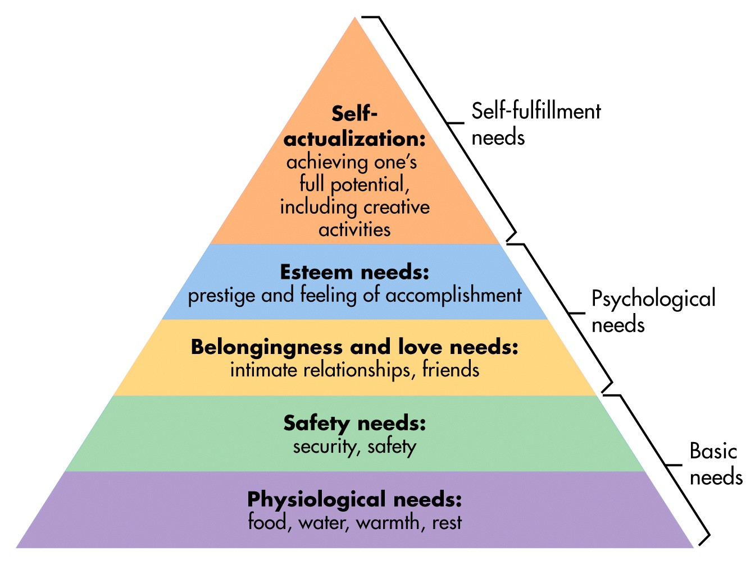
Maslow’s Hierarchy of Needs

Slide 6

Maslow’s Hierarchy of Needs
Maslow states that humans
will move up the pyramid as
their more basic needs get
met

Slide 7
What About Nations?
Nations and nation-states are made up of PEOPLE
Therefore, it is natural for nations to somewhat pursue things the same way that people do, along a hierarchy of needs
Successful nation-states, democratic ones especially look to satisfy the needs of their people

Slide 8
Economic Stability
Well being of nations people to support and take care of themselves
Employment
Nation-states attempt to provide
their economies with the best,
most qualified workforce
Nations take long-term and short-term plans to ensure economic stability

Slide 9
Peace and Security
Nation-states wish to provide their citizens with safety
Go to work, school, have freedoms
Sense of national safety and security
If the people are insecure, they are likely to oppose the government
Security of the person
Insecurity hurts the economy
Promotion of security
International Organizations, NATO, UN etc.
History of NATO
Darfur in 10 min.

Slide 10
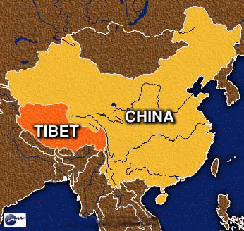
Self-Determination
Like people, nations and nation-states have a desire to be in control of their fate
Self-determination and Sovereignty
Collapse of Soviet Union
Indigenous Peoples
Self-Government
Recognition within a larger nation-state

Slide 11
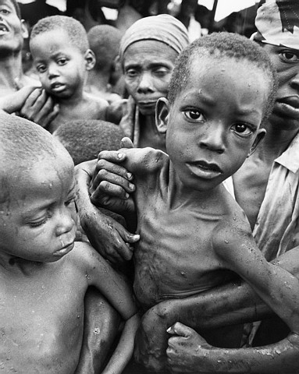
Humanitarianism
Actions to assist and relieve suffering and the innocent in the world
Natural Disasters
Disease
WHO
Right to Play 2
War/Conflict
Aid
Money and Supplies
Accepting Refugees
UN Sustainable Development Goals

Slide 12
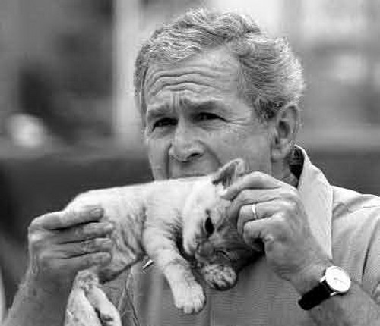
How Do Nation-States Respond to the World?
Isolationism
Complete opting out of participation in international affairs
Examples:
Feudal Japan
United States-interwar years, not joining L of N
Switzerland- remaining neutral
Unilateralism
Responding to events on their own
The United States – the Bush doctrine
Notes:
Different pundits would attribute different meanings to "the Bush Doctrine", as it came to describe other elements, including the controversial policy of preventive war, which held that the United States should depose foreign regimes that represented a potential or perceived threat to the security of the United States, even if that threat was not immediate; a policy of spreading democracy around the world, especially in the Middle East, as a strategy for combating terrorism; and a willingness to unilaterally pursue U.S. military interests.^{[3][4][5]} Some of these policies were codified in a National Security Council text entitled the National Security Strategy of the United States published on September 20, 2002.^{[6]}
The phrase "Bush Doctrine" was rarely used by members of the Bush administration. The expression was used at least once, though, by Vice President Dick Cheney, in a June 2003 speech in which he said, "If there is anyone in the world today who doubts the seriousness of the Bush Doctrine, I would urge that person to consider the fate of the Taliban in Afghanistan, and of Saddam Hussein's regime in Iraq."^{[7]}

Slide 13
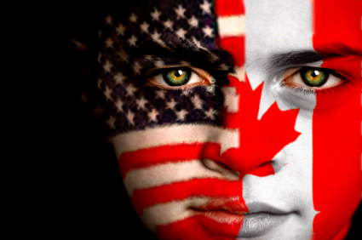

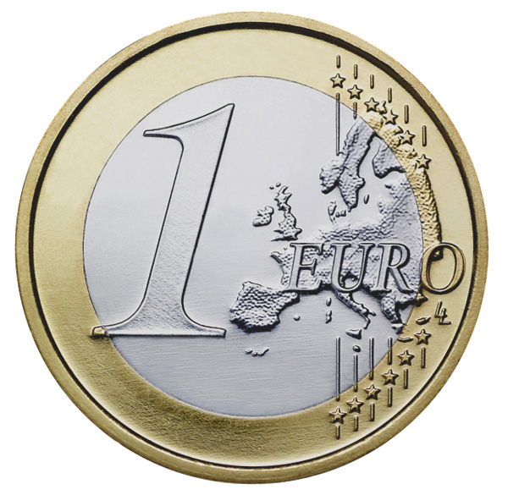
How Do Nation-States Respond to the World?
Bilateralism
2 countries together, motivated by the same want or need
Canada-US Air Quality Agreement
Multilateralism
Several Countries working together on an issue
Typically the approach of middle powers, increases their influence on issues when working in numbers
UN, WTO
Supranationalism
Agreeing to abide by the decisions of an international organization of independent officials
European Union – the Euro

Slide 14
How do nations respond?
Sovereignty
- political authority to control one’s own affairs
Voluntary Balkanization
- the separation of people into isolated and hostile groups
Collective Security
- all members of the community accept responsibility and act together to face the challenges that faces one or more of the members
Economic Sanctions
- the cutting off of trade with a country in an effort to force it to follow a particular course of action

Slide 15
Can you think of some ways that Canada interacts with the rest of the world? (What resources/goods do we produce for export? What ideas/values do we spread/promote? What type of impact do we have?)
Can you name some international organizations that Canada is involved in?
If Canada were a person, how would you describe her?

Slide 16
FOREIGN POLICY - Decisions about how to deal with other countries;
Decisions affect:
Where we get our food
Where we get our clothes, shoes, and other possessions that are not Canadian-made;
Television, music, we enjoy that is not Canadian-made
Employment and income from companies that are NOT Canadian-owned;
Rules of international travel and behavior while in someone else’s nation;

Slide 17
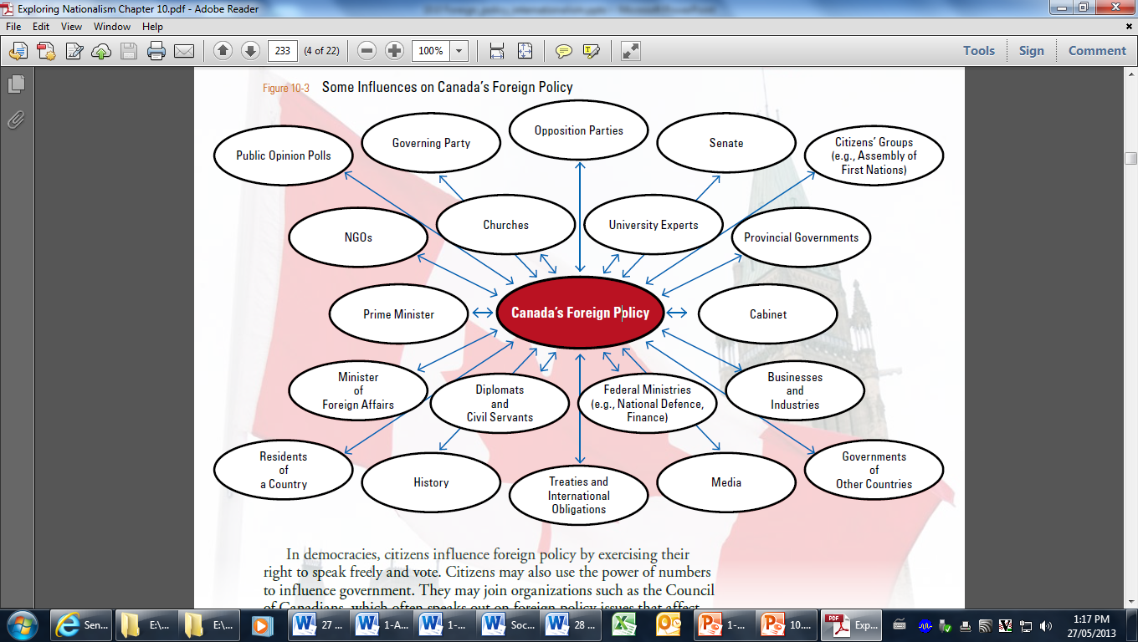
Influences on Foreign Policy

Slide 18
Canada and the world
NATO
Political alliance – members consult and cooperate to prevent conflict
Military alliance - Attack against one or several of its members is considered an attack against all
Provides collective security
Crisis management
28 members – links N.A. and Europe
http://www.nato.int/nato-welcome/index.html

Slide 19
Canada and the world
NORAD
North American Aerospace Defense Command –
Conducts aerospace warning and aerospace control in defense of N.A.
Bi-lateral partnership between U.S.A. and Canada

Slide 20

Canada and the world
North American Free Trade Agreement
Comprehensive trade agreement
Canada, Mexico and U.S.A.
Eliminates most tariff and non-tariff barriers to free trade

Slide 21
Canada and the world
Commonwealth of Nations
52 member states
Former colonies of British Empire
Share common values, history, culture, language
Work together to promote democracy, human rights, etc

Slide 22
Canada and the world
La Francophonie
84 member states
Organizes political activities and actions that benefit French-speaking populations
Promotes French language, peace and sustainable development
multilateral

Slide 23
Canada and the world
APEC
Asia-Pacific Economic Cooperation
21 members
Free trade agreement
multilateral

Slide 24
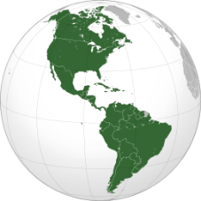
Canada and the world
OAS – Organization of American States
regional solidarity and cooperation among its member states
Strengthening democracy
Working for peace
Defending human rights:
Fostering free trade:
Fighting the drugs trade
Promoting sustainable development

Slide 25
Canada and the world
G8
http://www.abc.net.au/btn/story/s3784915.htm
Canada, France, Italy, Germany, Japan, UK, EU,
Russia (suspended)
goal is to talk about global topics and problems in a relaxed manner

Slide 26
USA FOREIGN POLICY
Isolationism – staying out of international affairs and events;
Eventually forced to react to WWI when merchant ship was sunk by German U-boat;
Eventually forced to react to WWII when Japanese bombed Pearl Harbour
Ceased isolation as foreign policy after WWII

Slide 27
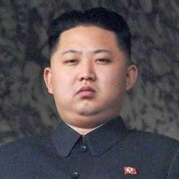
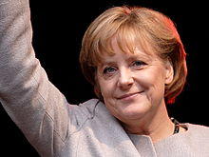
FOREIGN POLICY & POLITICAL SYSTEMS
DICTATORSHIPS – the national interest is determined by the leader and foreign policy based on that decision, even if individual citizens disagree;
DEMOCRACIES – elected leaders must ensure decisions reflect the beliefs, values, & goals of citizens. Individuals and collectives in a democracy influence foreign policy. If citizens disagree with foreign policy, they can vote for a change of government;

Slide 28
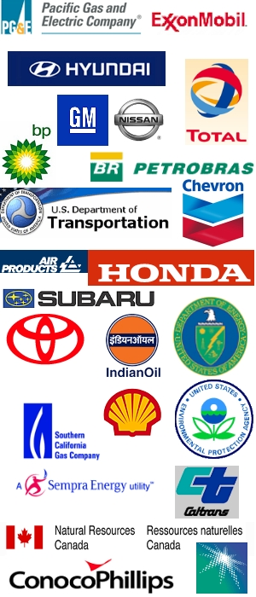

FOREIGN POLICY IN GLOBALIZING WORLD
Before WWII, nation-state governments & diplomats established foreign policy;
Since WWII, the role of nation-states has been reduced and;
Multinational corporations, international business, labour and humanitarian organizations have a more powerful role;
CONSEQUENCE OF GLOBALIZATION = the power of nation-states in decision-making regarding internationalism has been greatly reduced & that of corporations greatly increased.

Slide 29
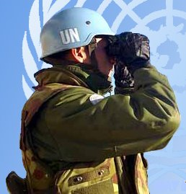

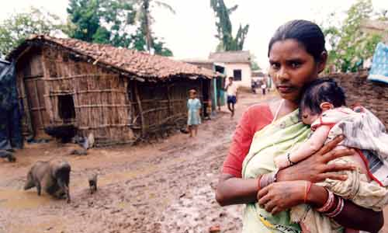
PROMOTING INTERNATIONALISM THROUGH FOREIGN POLICY
INTERNATIONAL LAW & AGREEMENTS;
PEACEKEEPING & PEACEMAKING;
FOREIGN AID

Slide 30
INTERNATIONAL LAW
Because foreign polices of some countries sometimes conflict, disputes can be resolved peacefully through a large body of international law and agreements.
Some international laws have evolved from international trade agreements and treaties. Others are based on UN conventions (policies) or agreements.
e.g. International Criminal Court (ICC) was created to try and punish people and organizations that commit crimes against humanity. Most nations of the world have joined the ICC because they believe it is in the interests of the international community to stop crimes against humanity and punish those who commit them.
https://www.icc-cpi.int/about

Slide 31
INTERNATIONAL LAW & AGREEMENTS
LAWS OF THE SEA = a form of international law created by the United Nations Convention on the Law of the Sea.
It is a set of rules for the high seas
All waters within 22 km of a nation's coastline are part of the nation's territory. Countries have the sole right to control fishing, mining, and the environment in an area up to 370 km from their coast. e.g. Law of the Seas applies to fishing on the Grand Banks off Canada' East Coast.
At one time the Grand Banks was the world's richest fishing grounds, but overfishing has threatened the very survival of fish stocks in this region. This has caused widespread unemployment in Canada, especially Newfoundland.
NATIONAL INTEREST: Canada believes it is in her national interest to regulate fishing on the entire Grand Banks.
Pursuing this "national interest" has led to conflict internationally.

Slide 32
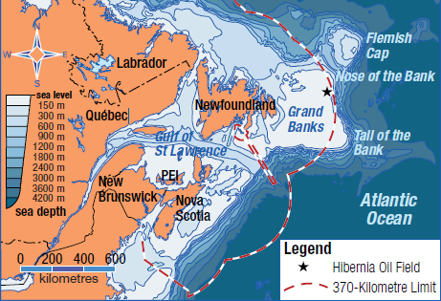
Turbot War

Slide 33
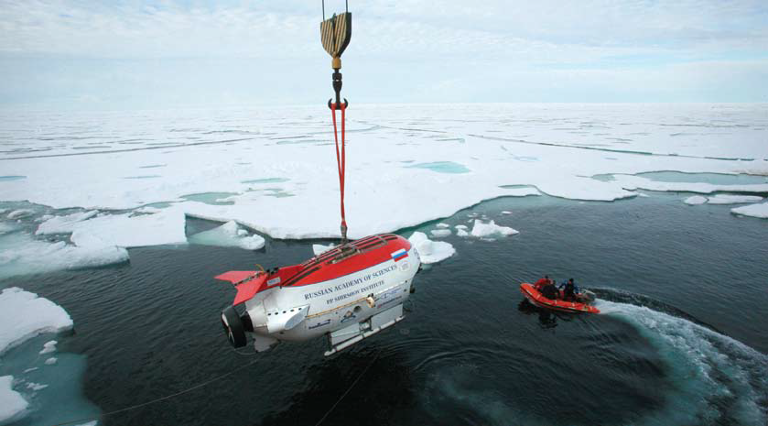
International Agreements
Arctic
But according to the Law of the Sea, the area around the North Pole is in international waters because it is located beyond the 370-kilometre limit
Five countries with Arctic claims. Canada, Denmark, Norway, Russia and the USA

Slide 34
PEACEKEEPING & PEACEMAKING
PEACEKEEPING = Peacekeepers are brought in to keep combatants (enemies) away from each other, long enough for peaceful negotiations and diplomacy to work to resolve the conflict.
UN Peacekeepers must be invited by a nation or peoples in conflict. Peacekeepers ARE NOT permitted to USE FORCE except in self defense of peacekeeping troops.
Peacekeeping is a form of international activity based on international agreements.
PEACEMAKING = Peacemakers are brought in to keep combatants (enemies) away from each other, long enough for peaceful negotiations and diplomacy to work to resolve the conflict.
Peacemakers' role includes peacekeeping, but also includes the USE OF FORCE to maintain the peace.
Peacemakers can intervene, for example, if someone is committing crimes against humanity, shooting or injuring civilians, as well as in self-defense.

Slide 35
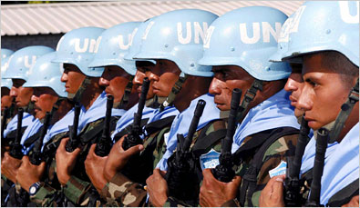
Peacekeeping – An International Activity

Slide 36
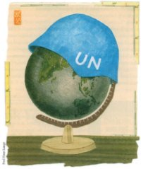
Peacekeeping is getting complicated…
More conflicts worldwide to monitor
Sometimes difficult to acquire consent from countries
Impartiality is difficult
Many of the conflicts exist within nations, not between nations
Can you think of an example of failed peacekeeping?

Slide 37
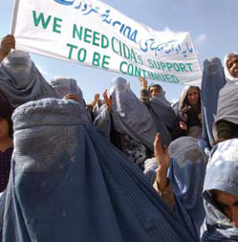
FOREIGN AID & INTERNATIONALISM

Slide 38
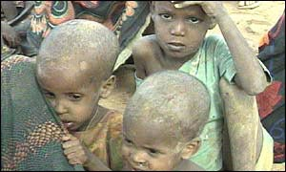
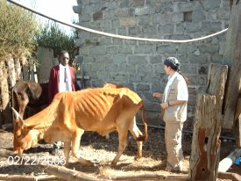
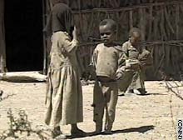
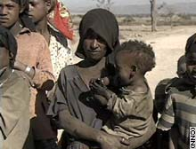
FOREIGN AID & INTERNATIONALISM What people want…
What do you think these people would value the most?

Slide 39
Understanding the World
Needs and Wants: These are relative terms that we must try to classify.
Write down all the things you would call needs that you have in your life.
What in your life dictates what you need?
What things on your list would the average person in a third world country not have?

Slide 40
Comparing Living Standards
The physical quality of life index was introduced by M.D. Morris and introduced in the 1970’s. It breaks quality of life down into:
Life expectancy
Infant mortality
Level of literacy
The categories show the population’s health and well being both socially and economically.

Slide 41
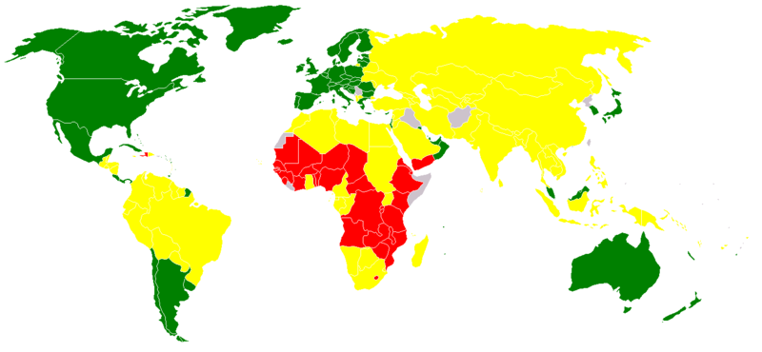
PQLF – Physical quality of life index
HDI ranking
Green = High human development
Yellow = Medium human development
Red = Low human development
Grey = Unavailable

Slide 42
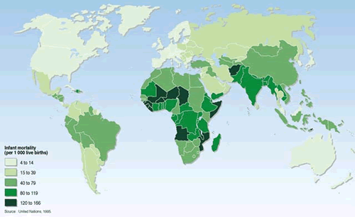
Infant Mortality – 1990

Slide 43
Infant Mortality
Infant mortality is seen as a marker of the level of health in a country.
In developing countries, one child in 12 dies before its fifth birthday, compared with 1 in 152 in high-income countries.
When there is a high birthrate there is a high infant mortality.
When nutrition in a country is poor, more infants will die.

Slide 44
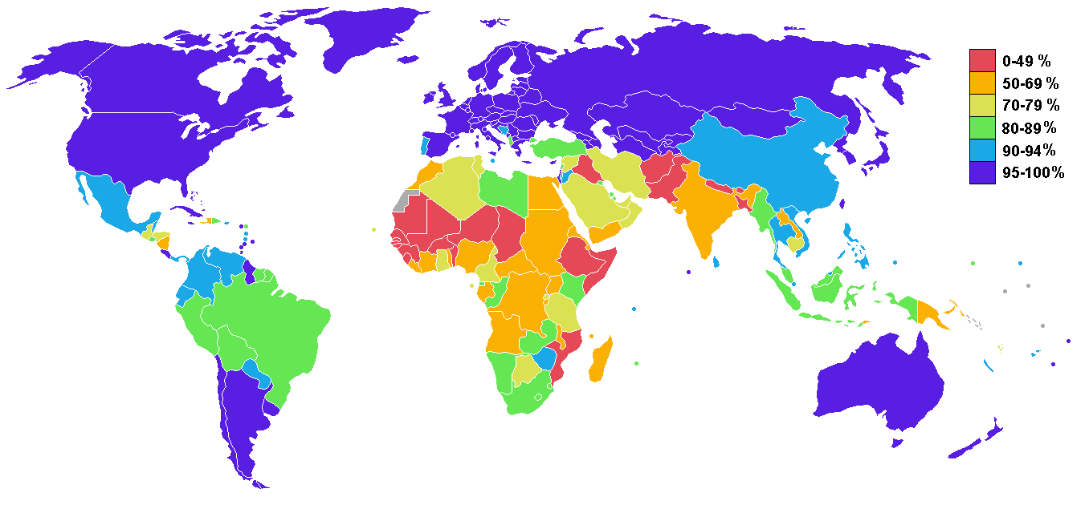
Literacy

Slide 45
Literacy
Percent of adult population that can read and write to a basic level.
Higher literacy leads to a higher quality of life.
Countries that have low levels of literacy struggle to grow technology, grow in hygiene, be informed of health risks, or job advancement.
People who cannot read often are taken advantage of by people who can read = exploitation.
UNESCO estimates that the # of illiterate people is growing because of the high birth rate of poor countries.

Slide 46
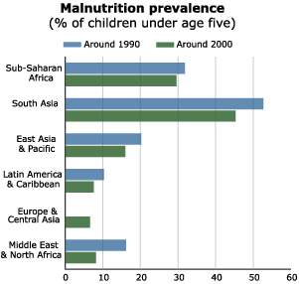
Nutrition
Malnutrition is an underlying factor in more than half the deaths of children under five.
Malnutrition in children often begins at birth, when poorly nourished mothers give birth to underweight babies.
Malnourished children develop more slowly, enter school later, and perform less well.
http://www.connect-world.net/Global_Themes/Children/Overview.html

Slide 47
Nutrition
Lack of an adequate diet leads to malnutrition.
Malnutrition = ill health
Kwashiorkor is a disease caused by a lack of protein in the diet.
Malnutrition stunts the mental and physical development of children, thereby crippling future generations

Slide 48
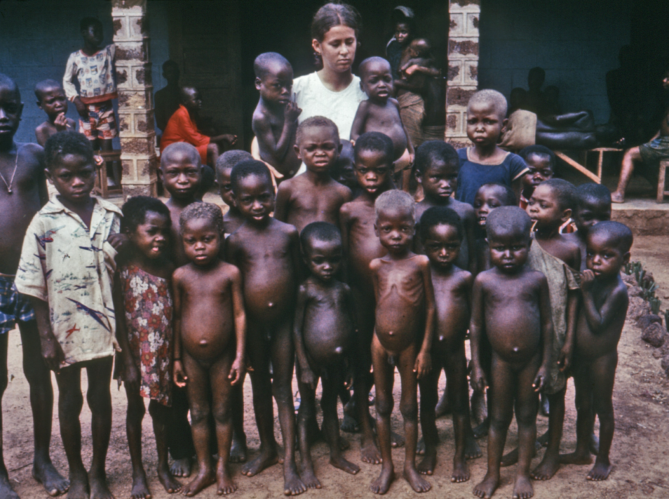

Slide 49
Famine
The world produces enough food to support the population of the world.
The problem is the allocation of food.
USA has the greatest surplus of food in the world.
Even in Africa, the countries produce enough food to feed their populations – yet there is still hunger…
Why? – people most in need of food cannot buy it.
Property owners use their land to produce cash crops to sell to the West.

Slide 50
The Hunger Cycle
1 in 6 babies is born underweight – vulnerable to disease and death
0-6 months, babies nourished by breast milk – but mothers are unhealthy.
Poor diet and heavy workload for pregnant mothers
6mos – 2 years, poverty and lack of parental education = inadequate solid food and early deaths.
Low paid job = unable to afford the right food in the right quantity.
3 years, malnutrition = mental development is stunted. No stimulation to develop.
Lack of energy and poor performance at school.

Slide 51
Struggling to Keep Up
Developed world has achieved increases in food production per capita.
The developing world has been less fortunate. Population growth in these countries uses up any increase in food production. BUT in most developing countries, except Africa, food production is increasing.
Famine in Africa is a significant problem.
South Sudan Air Drop
http://www.cbc.ca/news/world/south-sudan-famine-evans-1.4093264

Slide 52
Sudan (south, north, Darfur)
South Sudan BBC
http://www.bbc.com/news/av/world-africa-37779124/south-sudan-in-105-seconds
Darfur in 10 minutes
https://www.youtube.com/watch?v=USLDoIiFzzg
Should Canada help more? (CIDA worksheet)
http://www.international.gc.ca/development-developpement/countries-pays/index.aspx?lang=eng#focus
http://www.cbc.ca/radio/thecurrent/the-current-for-march-3-2017-1.4006937/famine-declared-in-south-sudan-thousands-at-risk-of-starvation-1.4007267

Slide 53
South sudan
http://www.cbc.ca/radio/thecurrent/the-current-for-march-3-2017-1.4006937/famine-declared-in-south-sudan-thousands-at-risk-of-starvation-1.4007267

Slide 54
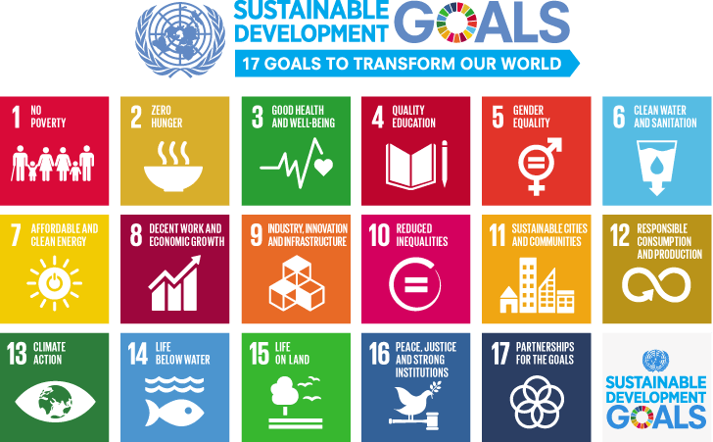
The World’s Response
Notes:
http://www.un.org/millenniumgoals/

Slide 55
0.7 Solution
Lester P. Pearson (former Canadian Prime Minister) suggested that developed countries pay 0.7 percent of their gross national income.
By 2006 Canada gave only 0.33 percent.
http://www.cbc.ca/news/politics/canadian-international-aid-drops-trudeau-1.4066640.

Slide 56
Types of Aid and Obstacles
Tied Aid: When aid is tied to conditions. Such as funding for water development, but the receiving country will have to “hire” a Canadian business to receive the aid. (Canada removed all “strings” in 2008)
Lack of consultation: Aid is given that is not necessary
Bureaucracy: Aid must go through government departments before it gets to the people who need it.
Corruption: Corrupt governments sometimes use aid money for other purposes that helping people in need.
Brain drain: Bright people in a country might begin working for aid agencies rather than for their own countries.

Slide 57
Terms
Absolute Poverty
severe deprivation of basic human needs
Odious Debt
debt incurred by a despotic power, not to meet the needs of the people of the country but to strengthen the despotic regime
Gross National Income
total value of the goods and services produced by a country in a year, whether inside or outside the country’s borders

Slide 58
Perspectives on Foreign Aid - darfur
Which arguments are the most convincing about the decision to give foreign aid?

Slide 59
Which foreign policy should Canada pursue the most?
Peacekeeping and peacemaking, International Law Agreements, or foreign aid?

